Slide 1
Team IC23056 Presentation
Christine Wang, Anthony Avelar
Link to Tableau dashboard: https://public.tableau.com/app/profile/christine4855/viz/GlobalClassrooms2/GlobalClassroomDash1_1

Slide 2
Main Guiding Questions
Our analysis focused on two questions related to student diversity:
(1) How is the student diversity of Global Classrooms compared to UMD College Park student diversity?
(2) How does the student diversity vary by semester and academic year?

Slide 3
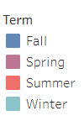
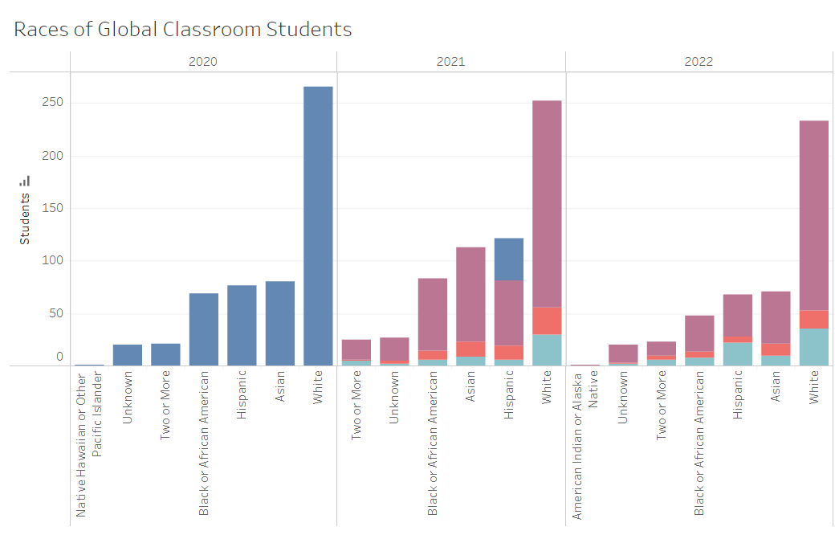
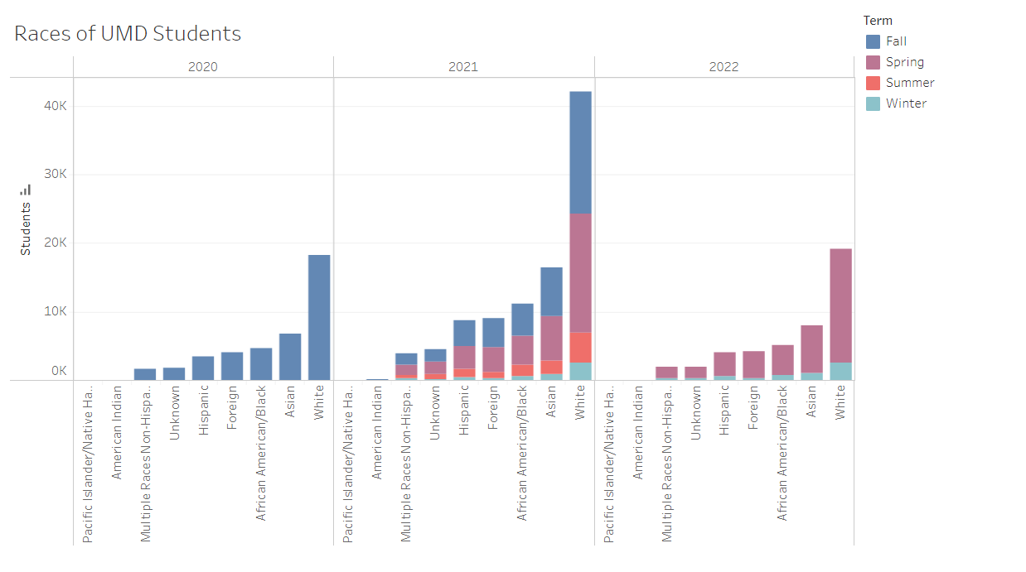
Question 1
Most represented races:
White
Asian
Hispanic
Black
How is the student diversity of Global Classrooms compared to UMD College Park student diversity?
INSERT PRETTY PICTURES HERE
> Pics that illustrate “Global Classroom” population vs general population of UMD
Notes:
Note: One observable trend is that the populations of Asian, Hispanic and Black students started low in 2020, rose in 2021, and then decreased in 2022.
Note: Hispanic & Asian are tied

Slide 4
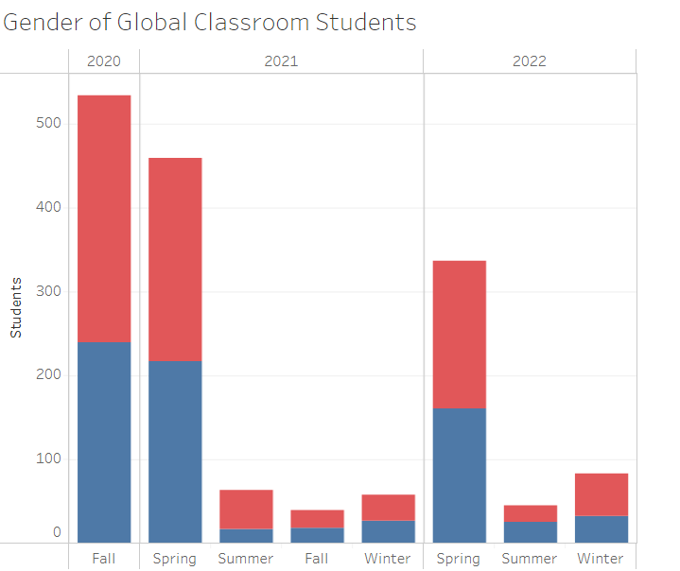

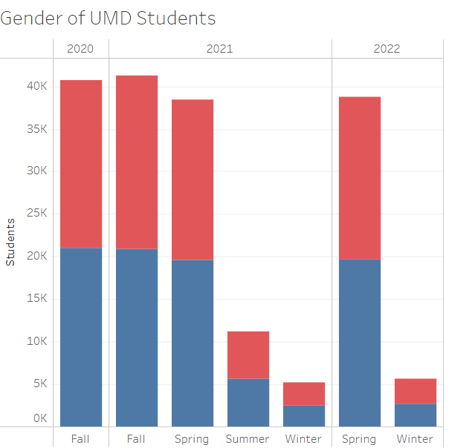
Question 2
How does the student diversity vary by semester and academic year?

Slide 5
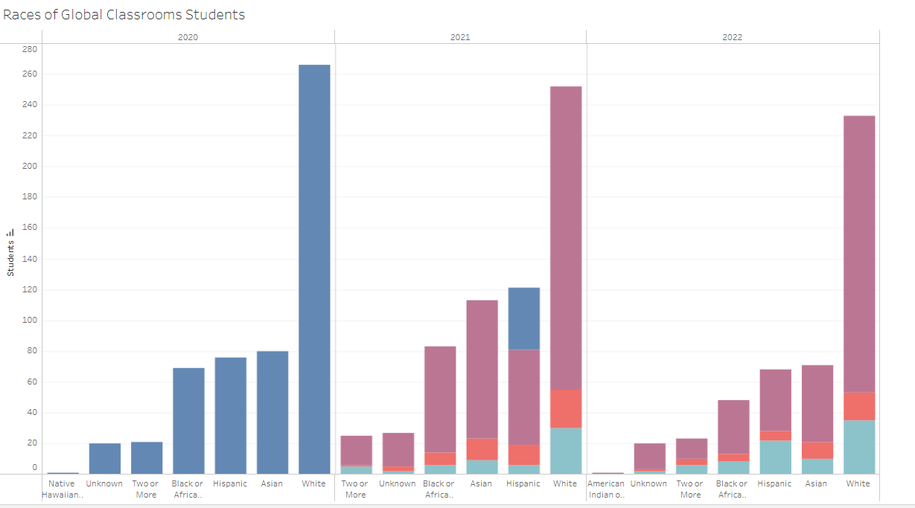
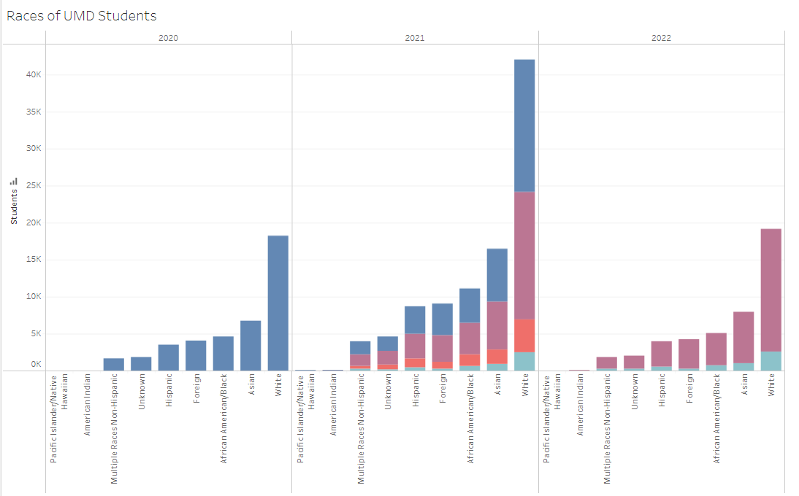

Slide 6
Datasets Referenced
OIA Dataset
IRIS Dataset

